Slide 1
Unit 2
Unit-02 : Public-Key cryptography and Hash Functions function 10 Hrs
Public-Key cryptography: Principles of Public-Key Cryptosystems, The RSA Algorithm, Diffie-Hellman Key Exchange.
Cryptographic Hash Functions: Applications of Cryptographic Hash Functions, Two simple hash functions, Requirements and security, secure hash algorithm (SHA).

Slide 2
Public Key Cryptosystem
public-key algorithms are based on mathematical functions rather than on substitution and permutation.
Public key cryptography is asymmetric, involving the use of two separate keys.
public-key encryption is more secure from cryptanalysis than is symmetric encryption.

Slide 3
Principles of Public Key Cryptosystem
Problem with the symmetric cryptosystem
Key Distribution
Either parties share the key securely.
Key distribution centre.
Public key Cryptosystem: Asymmetric algorithms rely on one key for encryption and a different but related key for decryption.
These algorithms have the following important characteristic
It is computationally infeasible to determine the decryption key given only knowledge of the cryptographic algorithm and the encryption key.
Either of the two related keys can be used for encryption, with the other used for decryption.

Slide 4
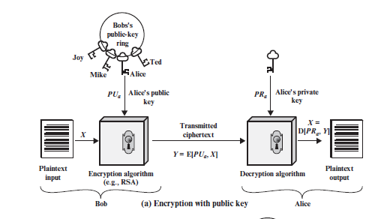
Asymmetric Cryptosystem- Encryption with public key

Slide 5
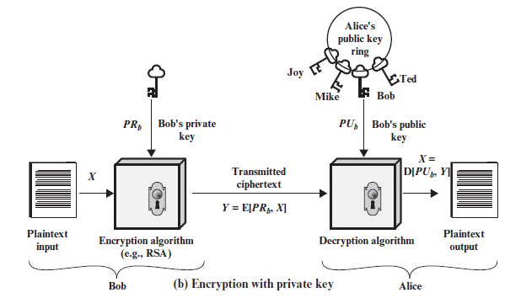
Asymmetric Cryptosystem- Encryption with private key

Slide 6
Ingredients of Public key cryptosystem
Plaintext: This is the readable message or data that is fed into the algorithm as input.
Encryption algorithm: The encryption algorithm performs various transformations on the plaintext.
Public and private keys: This is a pair of keys that have been selected so that if one is used for encryption, the other is used for decryption.
The exact transformations performed by the algorithm depend on the public or private key that is provided as input.

Slide 7
Ingredients of Public key cryptosystem
Ciphertext: This is the encrypted message produced as output. It depends on the plaintext and the key. For a given message, two different keys will produce two different ciphertexts.
Decryption algorithm: This algorithm accepts the ciphertext and the matching key and produces the original plaintext.

Slide 8
Public cryptosystem essential steps
Each user generates a pair of keys to be used for the encryption and decryption of messages.
Each user places one of the two keys in a public register or other accessible file. This is the public key. The companion key is kept private.
If Bob wishes to send a confidential message to Alice, Bob encrypts the message using Alice’s public key.
When Alice receives the message, she decrypts it using her private key. No other recipient can decrypt the message because only Alice knows Alice’s private key.

Slide 9
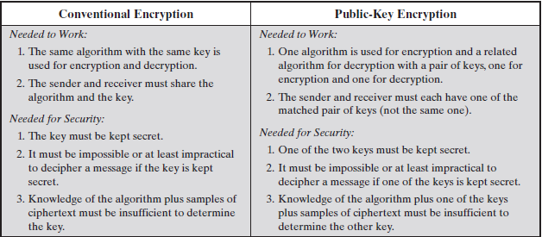
Conventional and Public-Key Encryption

Slide 10
Case Study- Public key encryption
Let us take a closer look at the essential elements of a public-key encryption scheme.
There is some source A that produces a message in plaintext, X = [X1, X2,.. .., XM].
The message is intended for destination B. B generates a related pair of keys: a public key, PUb, and a private key, PRb.
PRb is known only to B, whereas PUb is publicly available and therefore accessible by A.
With the message X and the encryption key PUb as input, A forms the ciphertext
Y = [Y1, Y2, c, YN]: Y = E(PUb, X)

Slide 11
Case Study- Public key Decryption
The intended receiver, in possession of the matching private key, is able to invert the transformation:
X = D(PRb,Y)
An adversary, observing Y and having access to PUb, but not having access to PRb or X, must attempt to recover X and/or PRb.
It is assumed that the adversary does have knowledge of the encryption (E) and decryption (D) algorithms.
If adversary interested to recover particular message, focus is to recover X by generating a plaintext.
If the adversary is interested in being able to read future messages as well, in which case an attempt is made to recover PRb by generating an estimate PRb*.

Slide 12
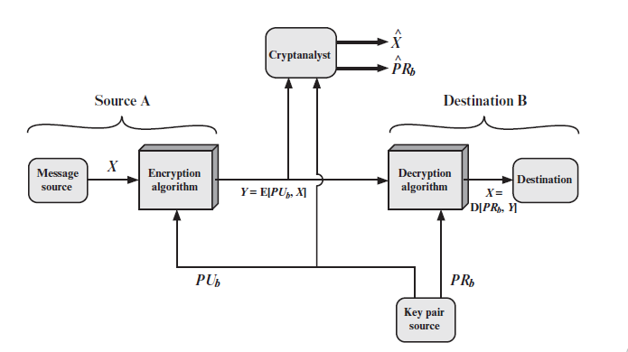
Public-Key Cryptosystem: Confidentiality

Slide 13
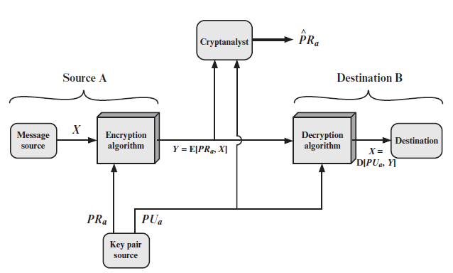
Public-Key Cryptosystem: Authentication

Slide 14
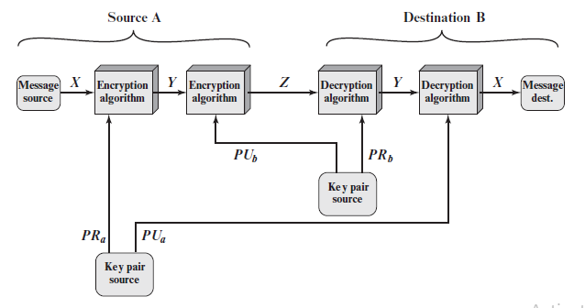
Public-Key Cryptosystem: Authentication and Secrecy

Slide 15
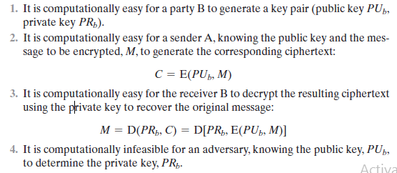
Requirements for Public-Key Cryptography

Slide 16
The RSA Algorithm
One of the first successful public key crypto based algorithm was developed in 1977 by Ron Rivest, Adi Shamir, and Len Adleman at MIT.
The RSA scheme is a cipher in which the plaintext and ciphertext are integers between 0 and n - 1 for some n.
A typical size for n is 1024 bits, or 309 decimal digits.

Slide 17

Description of the Algorithm
RSA makes use of an expression with exponentials. Plaintext is encrypted in blocks, with each block having a binary value less than some number n.
That is, the block size must be less than or equal to log2(n) + 1; in practice, the block size is i bits, where 2i 6 n … 2i+1.
Encryption and decryption are of the following form, for some plaintext block M and ciphertext block C.

Slide 18
Cont..
Both sender and receiver must know the value of n.
The sender knows the value of e, and only the receiver knows the value of d.
Thus, this is a public key encryption algorithm with a public key of PU = {e, n} and a private key of PR = {d, n}.
For this algorithm to be satisfactory for public-key encryption, Some requirements must be met.
It is possible to find values of e, d, and n such that Med mod n = M for all M 6 n.
It is relatively easy to calculate Me mod n and Cd mod n for all values of M 6 n.
It is infeasible to determine d given e and n.

Slide 19
Key Generation Method
Select two prime numbers, p = 17 and q = 11.
Calculate n = pq = 17 * 11 = 187
Calculate f(n) = (p - 1)(q - 1) = 16 * 10 = 160.
Select e such that e is relatively prime to f(n) = 160 and less than f(n); choose e = 7.
Determine d such that de K 1 (mod 160) and d 6 160.
The correct value is d = 23, because 23 * 7 = 161 = (1 * 160) + 1; d can be calculated using the extended Euclid’s algorithm.
The resulting keys are public key PU = {7, 187} and private key PR = {23, 187}.

Slide 20
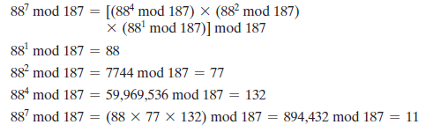
Problem
Input plaintext M=88. perform both encryption and decryption.
For encryption, we need to calculate C = 88^7 mod 187.

Slide 21
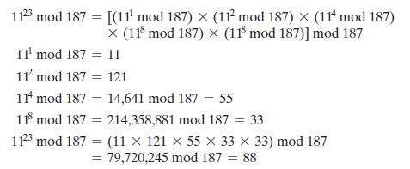
Decryption
For decryption, we calculate M = 11^23mod 187.

Slide 22
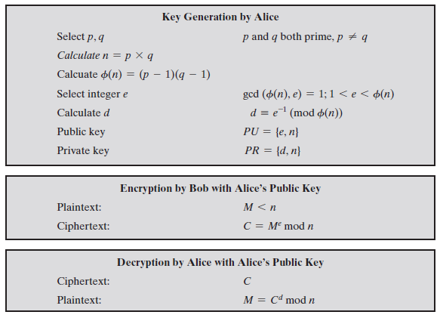
The RSA Algorithm

Slide 23
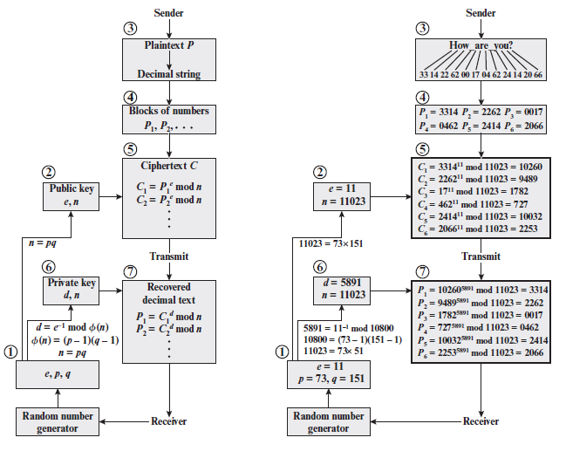
RSA processing of multiple blocks

Slide 24
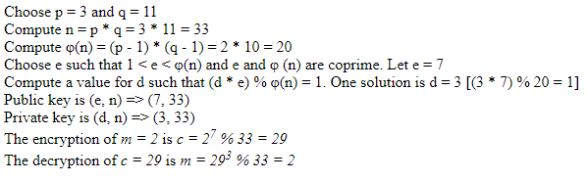
RSA example-02
Choose p=3 and q=11 and perform RSA encryption and decryption.

Slide 25

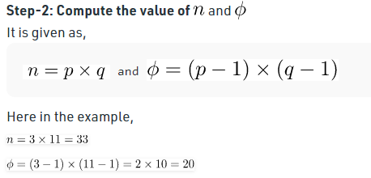
Example-RSA Key generation alternative method

Slide 26
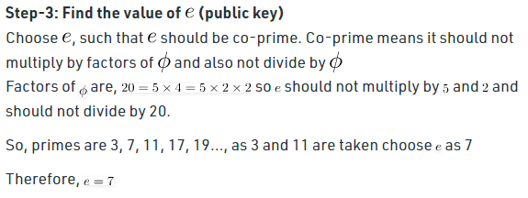
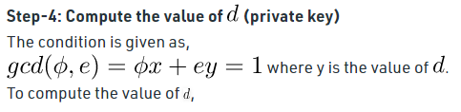
Cont..

Slide 27
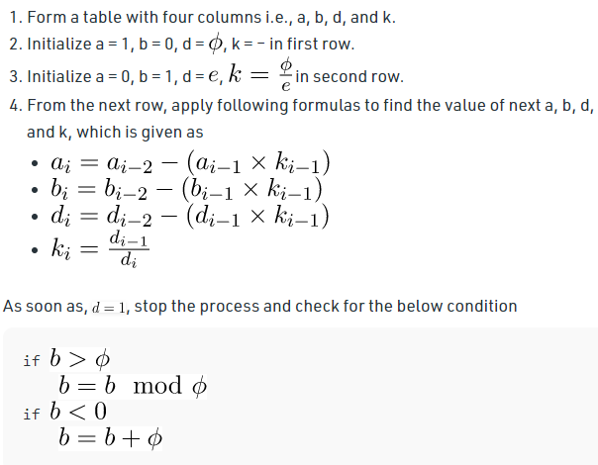
Cont..

Slide 28
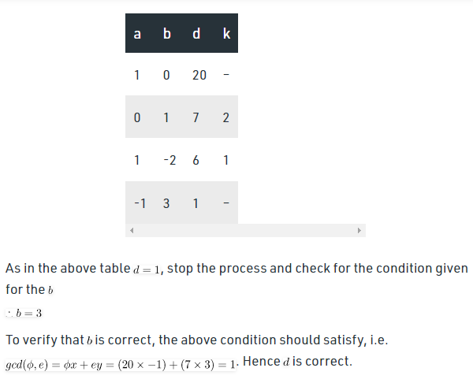
Cont..

Slide 29
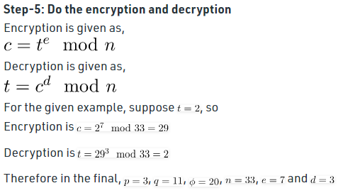
Cont..

Slide 30
DIFFIE–HELLMAN KEY EXCHANGE
The purpose of the algorithm is to enable two users to securely exchange a key that can then be used for subsequent symmetric encryption of messages.
The algorithm itself is limited to the exchange of secret values.
The Diffie–Hellman algorithm depends for its effectiveness on the difficulty of computing discrete logarithms.
The DH algorithm based on discrete logarithm.
This algorithm facilitates the exchange of secret key without actually transmitting it.

Slide 31
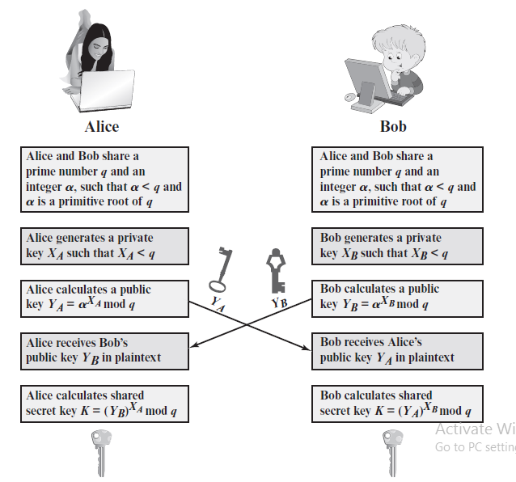
The Algorithm

Slide 32
D-H Key Exchange
There are two publicly known numbers: Prime number q and an integer α that is a primitive root of q.
Suppose the users A and B wish to create a shared key, They follow the below steps;
User A selects a random integer XA < q and computes YA = α^XA mod q.
Similarly, user B independently selects a random integer XB <q and computes YB = α^XB mod q.
Each side keeps the X value private and makes the Y value available publicly to the other side.
Thus, XA is A’s private key and YA is A’s corresponding public key, and similarly for B.
User A computes the key as K = (YB)^XA mod q and user B computes the key as K = (YA)^XB mod q.

Slide 33
Problem-01
Suppose that two parties A and B wish to set up a common secret key (D-H key) between themselves using the Diffie Hellman key exchange technique. They agree on 7 as the modulus and 3 as the primitive root. Party A chooses 2 and party B chooses 5 as their respective secrets. Their D-H key is-
3
4
5
6

Slide 34
Solution
Given-
n = 7
a = 3
Private key of A = 2
Private key of B = 5
Step-01:
Both the parties calculate the value of their public key and exchange with each other.
Public key of A
= 3^{private key of A} mod 7
= 3² mod 7
= 2
Public key of B
= 3^{private key of B} mod 7
= 3⁵ mod 7
= 5

Slide 35
Solution
Step-02:
Both the parties calculate the value of secret key at their respective side.
Secret key obtained by A
= 5^{private key of A} mod 7
= 5² mod 7
= 4
Secret key obtained by B
= 2^{private key of B} mod 7
= 2⁵ mod 7
= 4
Finally, both the parties obtain the same value of secret key.
The value of common secret key = 4. Thus, Option (B) is correct.

Slide 36
Example-02
Consider q=353, α= 3 ( 3 is primitive root of 353)
A and B discrete private keys
XA=97and XB=223
Each computes its public key
A computes YA=3^97 mod 353 =40
B computes YB=3^233 mod 353 = 248
After exchange of public keys, each can compute the common secret key
A computes K =(YB)^XAmod 353=(248)^97mod 353=160
B computes K =(YA)^XBmod 353=(40)^253mod 353=160

Slide 37
Man-in-the-Middle Attack
The protocol depicted in DH Algorithm is insecure against a man-in-the-middle attack.
Suppose Alice and Bob wish to exchange keys, and Darth is the adversary.
The attack proceeds as follows:
Darth prepares for the attack by generating two random private keys XD1 and XD2 and then computing the corresponding public keys YD1 and YD2.
Alice transmits YA to Bob.
Darth intercepts YA and transmits YD1 to Bob.
Darth also calculates K2 = (YA)^XD2 mod q.
Bob receives YD1 and calculates K1 = (YD1)^XB mod q.
Bob transmits YB to Alice.
Darth intercepts YB and transmits YD2 to Alice. Darth calculates K1 = (YB)XD1 mod q.
Alice receives YD2 and calculates K2 = (YD2)^XA mod q.

Slide 38
Cont..
At this point, Bob and Alice think that they share a secret key, but instead Bob and Darth share secret key K1 and Alice and Darth share secret key K2.
All future communication between Bob and Alice is compromised in the following way.
Alice sends an encrypted message M: E(K2, M).
Darth intercepts the encrypted message and decrypts it to recover M.
Darth sends Bob E(K1, M) or E(K1, M*), where M* is any message.
The key exchange protocol is vulnerable to such an attack because it does not authenticate the participants.
This vulnerability can be overcome with the use of digital signatures and public-key certificates

Slide 39
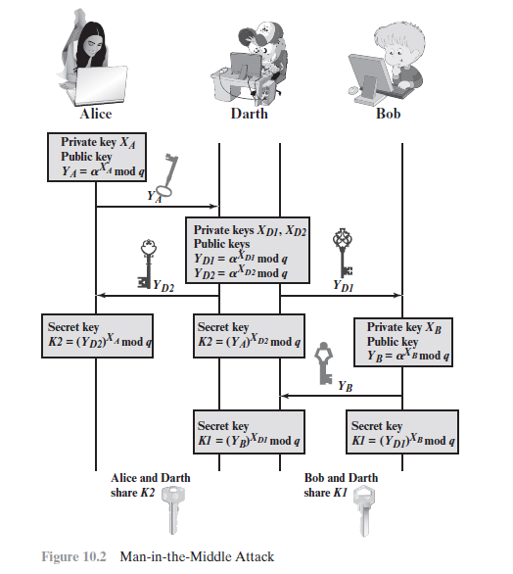
Man-in the-Middle Attack

Slide 40
Cryptographic Hash Function
A hash function H accepts a variable-length block of data M as input and produces a fixed-size hash value h = H(M).
In general terms, the principal object of a hash function is data integrity.
A change to any bit or bits in M results, with high probability, in a change to the hash value.
The kind of hash function needed for security applications is referred to as a cryptographic hash function.
Typically, the input is padded out to an integer multiple of some fixed length (e.g., 1024 bits), and the padding includes the value of the length of the original message in bits.

Slide 41
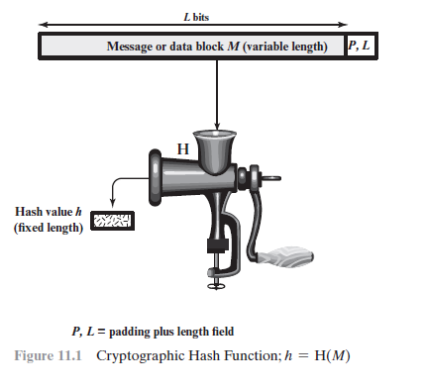
Hashing Mechanism

Slide 42
Applications of cryptographic hash functions
It is used in a wide variety of security applications and Internet protocols.
Message Authentication: Message authentication is a mechanism or service used to verify the integrity of a message.
Message authentication assures that data received are exactly as sent (i.e., there is no modification, insertion, deletion, or replay).
The hash function value is often referred to as a message digest.

Slide 43
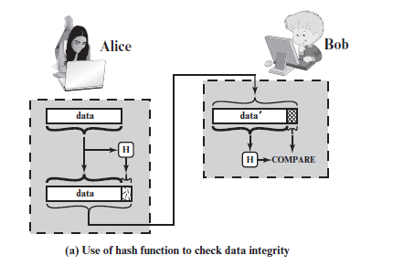
Hashing function for message authentication

Slide 44
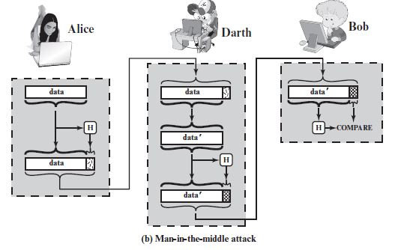
Attacks on hash values
The hash value must be transmitted in a secure fashion.
The hash value must be protected so that if an adversary alters or replaces the message, it is not feasible for adversary to also alter the hash value to fool the receiver.

Slide 45
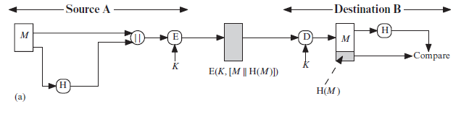
Hash codes used for message authentication
The following ways in which a hash code can be used to provide message authentication, as follows.
The message plus concatenated hash code is encrypted using symmetric encryption. Because only A and B share the secret key, the message must have come from A and has not been altered.
The hash code provides the structure or redundancy required to achieve authentication. Because encryption is applied to the entire message plus hash code, confidentiality is also provided.

Slide 46
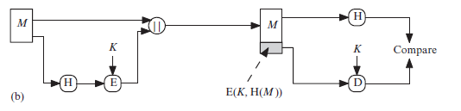
Message Authentication
Only the hash code is encrypted, using symmetric encryption. This reduces the processing burden for those applications that do not require confidentiality.
It is possible to use a hash function but no encryption for message authentication.
The technique assumes that the two communicating parties share a common secret value S. A computes the hash value over the concatenation of M and S and appends the resulting hash value to M. Because B possesses S, it can recompute the hash value to verify. Because the secret value itself is not sent, an opponent cannot modify an intercepted message and cannot generate a false message.

Slide 47
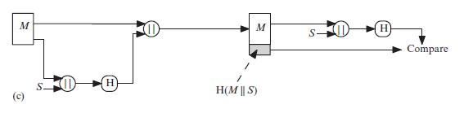
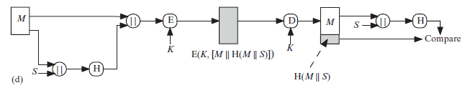
Message Authentication
Confidentiality can be added to the approach of method (c) by encrypting the entire message plus the hash code.

Slide 48
Message Authentication
More commonly, message authentication is achieved using a Message Authentication Code (MAC), also known as a keyed hash function.
Note that the combination of hashing and encryption results in an overall function that is, a MAC(Fig. b).
That is, E(K, H(M)) is a function of a variable-length message M and a secret key K, and it produces a fixed-size output that is secure against an opponent who does not know the secret key.
Specific MAC algorithms are designed that are generally more efficient than an encryption algorithm.

Slide 49
Digital Signatures
Another important application, which is similar to the message authentication application, is the digital signature.
The operation of the digital signature is similar to that of the MAC.
In the case of the digital signature, the hash value of a message is encrypted with a user’s private key.
Anyone who knows the user’s public key can verify the integrity of the message that is associated with the digital signature.
The hash code is encrypted, using public-key encryption with the sender’s private key. As with Figure 11.3b, this provides authentication. It also provides a digital signature, because only the sender could have produced the encrypted hash code. In fact, this is the essence of the digital signature technique.

Slide 50
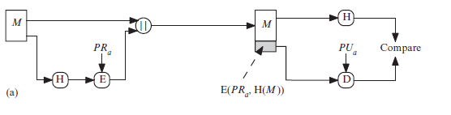
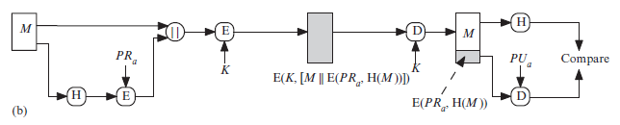
Digital Signature
If confidentiality as well as a digital signature is desired, then the message plus the private-key-encrypted hash code can be encrypted using a symmetric secret key. This is a common technique.

Slide 51
Other Applications
Hash functions are commonly used to create a one-way password file.
Hash functions can be used for intrusion detection and virus detection.
A cryptographic hash function can be used to construct a pseudorandom function (PRF) or a pseudorandom number generator (PRNG).

Slide 52
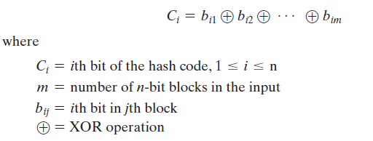
TWO SIMPLE HASH FUNCTIONS
The input (message, file, etc.) is viewed as a sequence of n -bit blocks.
The input is processed one block at a time in an iterative fashion to produce an n-bit hash function.
One of the simplest hash functions is the bit-by-bit exclusive-OR (XOR) of every block.
This can be expressed as

Slide 53
2 simple hash function
This operation produces a simple parity bit for each bit position and is known as a longitudinal redundancy check.
It is reasonably effective for random data as a data integrity check.
A simple way to improve matters is to perform a one-bit circular shift, or rotation, on the hash value after each block is processed.
The procedure can be summarized as follows
Initially set the n-bit hash value to zero.
Process each successive n-bit block of data as follows:
Rotate the current hash value to the left by one bit.
XOR the block into the hash value.

Slide 54
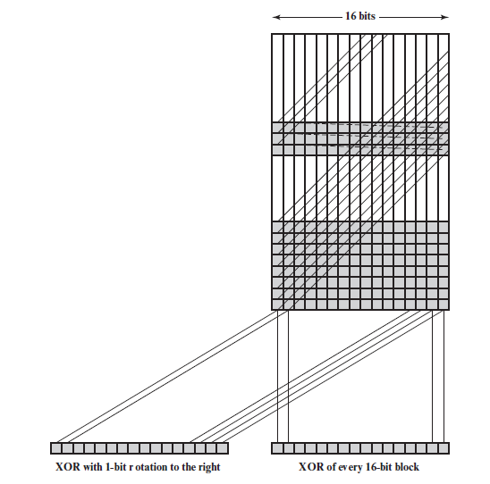
2 simple hash functions

Slide 55
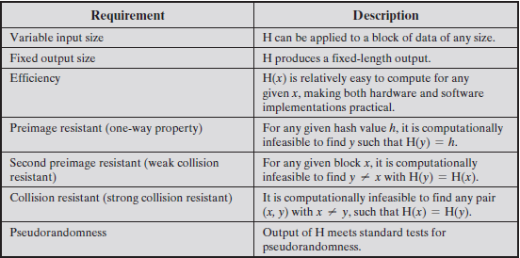
Security Requirements for Cryptographic Hash Functions

Slide 56
Requirements of hash function
The fourth property, preimage resistant, is the one-way property.
It is easy to generate a code given a message, but virtually impossible to generate a message given a code.
This property is important if the authentication technique involves the use of a secret value.
If the hash function is not one way, an attacker can easily discover the secret value.
The fifth property, second preimage resistant, guarantees that it is infeasible to find an alternative message with the same hash value as a given message.
A hash function that satisfies the first five properties in Table is referred to as a weak hash function.
If the sixth property, collision resistant, is also satisfied, then it is referred to as a strong hash function.

Slide 57
Requirements of hash function
A strong hash function protects against an attack in which one party generates a message for another party to sign.
For example, suppose Bob writes an IOU message, sends it to Alice, and she signs it.
Bob finds two messages with the same hash, one of which requires Alice to pay a small amount and one that requires a large payment.
Alice signs the first message, and Bob is then able to claim that the second message is authentic.

Slide 58
SECURE HASH ALGORITHM (SHA)
The most widely used hash function has been the Secure Hash Algorithm (SHA).
SHA was more or less the last remaining standardized hash algorithm by 2005.
The actual standards document is entitled “Secure Hash Standard.” SHA is based on the hash function MD4.
SHA-1 produces a hash value of 160 bits.
In 2002, NIST produced a revised version of the standard, that defined three new versions of SHA, with hash value lengths of 256, 384, and 512 bits, known as SHA-256, SHA-384, and SHA-512, respectively.
Collectively, these hash algorithms are known as SHA-2.
These new versions have the same underlying structure and use the same types of modular arithmetic and logical binary operations as SHA-1.

Slide 59
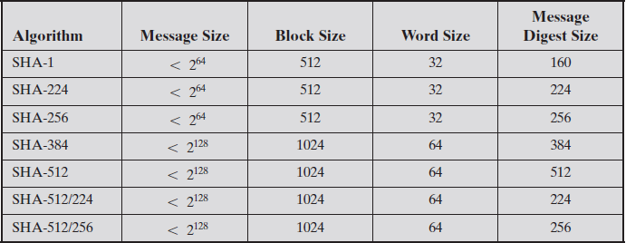
Comparison of SHA Parameters

Slide 60
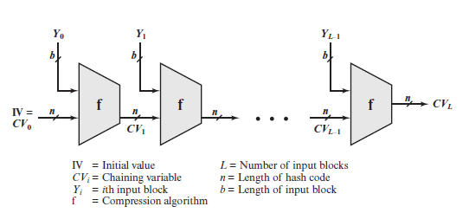
SHA-512 Logic
The algorithm takes as input a message with a maximum length of less than 2128 bits and produces as output a 512-bit message digest.
The input is processed in 1024-bit blocks.

Slide 61
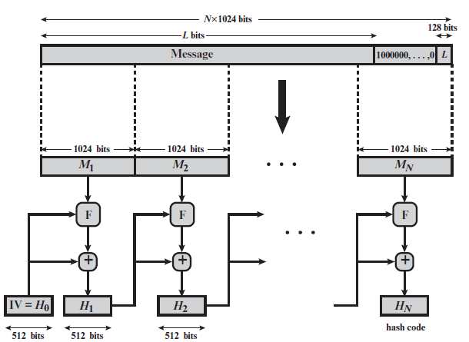
Message Digest Generation Using SHA-512

Slide 62
SHA-512 execution steps
Step 1 :Append padding bits - The message is padded so that its length should match the message desired length.
The padding consists of a single 1 bit followed by the necessary number of 0 bits.
Step 2 :Append length- A block of 128 bits is appended to the message.
This block is treated as an unsigned 128-bit integer.
Also it contains the length of the original message in bits (before the padding).
The outcome of the first two steps yields a message that is an integer multiple of 1024 bits in length.
In Figure , the expanded message is represented as the sequence of 1024-bit blocks M1, M2, c, MN, so that the total length of the expanded message is N * 1024 bits.

Slide 63
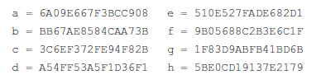
SHA-512 execution steps
Step 3 Initialize hash buffer- A 512-bit buffer is used to hold intermediate and final results of the hash function.
The buffer can be represented as eight 64-bit registers (a, b, c, d, e, f, g, h).
These registers are initialized to the following 64-bit integers (hexadecimal values):
These values are stored in big-endian format, which is the most significant byte of a word in the low-address (leftmost) byte position.

Slide 64
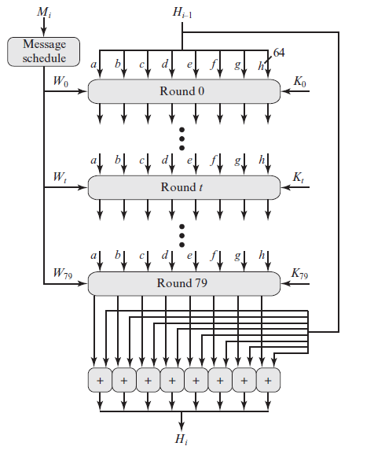
SHA-512 execution steps
Step 4 Process message in 1024-bit (128-byte) blocks- The heart of the algorithm is a module that consists of 80 rounds; this module is labeled as F.

Slide 65
Round Function
Each round takes as input the 512-bit buffer value, abcdefgh, and updates the contents of the buffer.
At input to the first round, the buffer has the value of the intermediate hash value, Hi-1.
Each round t makes use of a 64-bit value Wt, derived from the current 1024-bit block being processed (Mi).
Each round also makes use of an additive constant Kt, where 0 … t … 79 indicates one of the 80 rounds.
These words represent the first 64 bits of the fractional parts of the cube roots of the first 80 prime numbers.
The output of the eightieth round is added to the input to the first round (Hi-1) to produce Hi.
The addition is done independently for each of the eight words in the buffer with each of the corresponding words in Hi-1, using addition modulo 264

Slide 66
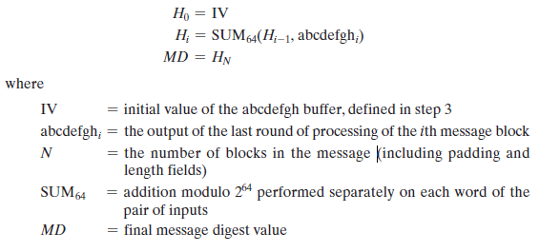
SHA execution steps
Step 5 Output- After all N 1024-bit blocks have been processed, the output from the Nth stage is the 512-bit message digest.
We can summarize the behavior of SHA-512 as follows:

